Slide 1
Git Workshop

Slide 2
Introduction
Benefits and Git Basics

Slide 3
Benefits of Using Git
Never having to worry about work being lost
Great code collaboration within a team
Managing releases for different environments
Manipulate code to your liking
Ability to read and write history of code
Notes:
Here are the benefits of getting proficient at Git: Never having to worry about lost work because as long as it’s committed to Git, it’ll always be there. I would like to stress this: as long as it’s committed, we can always find ways to get it back, even if it feels like we’ve done something terrible. It also allows teams to collaborate with each other, combining features and sharing code. Getting better at Git allows your team to easily handle releases for different environments. If you need to work on a hotfix in production while at the same time, adding a specific feature from DEV? Yes, you can do it with Git! Add to this, you can manipulate code to your liking. Lastly, it allows us to read and write the history of our code.
This will be a workshop so be prepared to write trivial code. If you’re not ready with an IDE, we can also just use Git on .txt files.

Slide 4
Workshop Flow
What is Git?
Install & Setup
Commits & Branches
Git Config & Aliases
Save Points During Development
Managing Commits to Tell a Story
Merge Conflicts
Resolving
Reducing
Managing Releases
Team Git Workflows
Notes:
So if that enticed you, let’s look at the flow of this workshop. First, a brief overview of Git then, we’ll go to installation and setup. We’ll use Git CLI since it offers us full functionality. Next is a primer on commits and branches to make sure we’re on the same page. Then, we’ll set up our Git config and aliases so a few specific commands will have more descriptive names.
After the basics, we’ll move on to personal workflows that can improve our development process and collaboration with others. Next, we’ll take a look at the infamous merge conflicts and how to effectively resolve them. I think we’re being hindered by our Git tools and it’s much easier to do it using Git CLI. Aside from that, we’ll discuss ways to reduce merge conflicts for smoother teamwork.
Once we’re comfortable with our personal workflows, we can move on to empower the team with our Git expertise. We’ll discuss managing releases, selecting features to include, and handling of scenarios relating to different environments. Lastly, we’ll talk about Team Git Workflows that empower us in our chosen release strategy. Whether it’s CI/CD with numerous deploys per day or just weekly deploys.
So, let’s move on to the basics of Git.
Note: Discussion on Git tools/GUI vs Git CLI will be discussed on installation.

Slide 5
What is Git?
Source Control Management (SCM)
Tracks and manages changes to code
OR Version Control System (VCS)
Allows handling of different versions
Allows collaboration between developers
Infamously riddled with difficult merge conflicts
Distributed SCM/VCS
Whole repo lives in each local, and just sync through a remote repo
Notes:
First off, what is Git? What are these fancy words? Source Control Management? Distributed SCM? Basically, Git tracks and manages changes to our code. It sounds simple yet it’s powerful. Another name for it is version control system, which for me, describes it much better. It allows us to handle different versions of code, the version in which you are developing feature A, or another version wherein your teammate is working on another feature. This also includes the older version that has been deployed to production, and the newer version in which developers are writing new features in. It also allows combining of versions, ending up in a version with all the features from all developers. This is more commonly known as merging, when merge conflicts infamously make our lives difficult.
Furthermore, it’s a distributed system, which just means that the repo resides in everyone’s machines and is synced through a remote repo. This is different from a centralized one wherein there’s only one server and many clients. In this case, the server holds all the versions and the clients just get it from the server. Whereas in Git, each one has access to all the versions and branches of the remote repository. Disclaimer: I’m not quite sure about the centralized one. Anyway, let’s move on to Git’s building blocks: commits & branches

Slide 6

What are Commits?
Snapshots of your code base
You can always go back to any specific commit
Unique ID is made by hashing the contents, date, time, and etc.
You can have exactly the same code base but different commits
Let’s treat it as the indivisible unit of work
Notes:
So, commits are snapshots of your code base, or I also see them as save points. You can always go back to any specific commit. Actually, you can save your Git repo from virtually any disaster, it could be a wrongful push, merge, rebase, etc. Looking at the commit below: we can see its commit ID, ee35dd, and the branches that are currently pointed to it. The name and e-mail of the author is also there, including the date, and the commit title and message.
Let’s look at the commit ID, this ID is unique and is actually the hash of your contents, date, and etc. So this means that, we could have the exact same contents for our repo but different commits. As for the purposes of this workshop, let’s treat commits as the indivisible unit of work. It’s like an atom, there’s nothing smaller than it. You can arrange atoms, combine or remove them. Basically do anything you want, but you can’t split them. Same thing for our commits. Next, we have branches.

Slide 7

Git Branches
Lightweight, movable pointer to a commit
Line of development
Notes:
Superficial use of Git branches mimic plant branches in real life. You have the main thick trunk, from which various branches connect. This is similar to Git’s main/master, and its feature branches. However, I’m afraid the analogy falls short as soon as you talk about Git branches’ main use, and that is merging. Another way to think about this is that branches are lines of development. These lines can intersect, converge, or even create new lines. Examples of these lines would be, a line dedicated to working on the login page, one for the user profile, and others for various features. There could also be lines pertaining to each environment, this one’s for dev, that one’s for production.
However, its actual definition according to [Pro Git] is “a lightweight, movable pointer to a commit”. But, for simplicity’s sake, let’s just look at it as a line of development.
Resources:
https://git-scm.com/book/en/v2/Git-Branching-Branches-in-a-Nutshell [Pro Git]
https://www.atlassian.com/git/tutorials/using-branches/git-merge

Slide 8
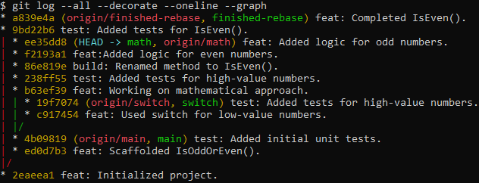
Another Example of Git Branches
Notes:
So here is a more detailed example of Git commits and branches. This Git history shows us someone who wants to implement a simple method for determining if a number is even. First thing he does is do it using a switch-case, as you can see from the switch branch on the right. He initialized the project, scaffolded, wrote tests but stopped developing. Instead he tried the mathematical approach on the math branch. Then, there’s another branch called the finished-rebase whose contents are exactly the same as the math branch. But, it has much less commits. We’ll discuss the motivation for this branch with lesser commits soon.

Slide 9
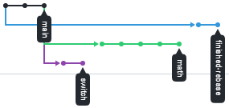
Another Example of Git Branches
Notes:
So here is a more detailed example of Git commits and branches. This Git history shows us someone who wants to implement a simple method for determining if a number is even. First thing he does is do it using a switch-case, as you can see from the switch branch on the right. He initialized the project, scaffolded, wrote tests but stopped developing. Instead he moved on to develop using a mathematical approach on the math branch. Then, there’s another branch called the finished-rebase whose contents are exactly the same as the math branch, but it has much less commits. We’ll soon discuss the motivation for this branch with lesser commits. But first off, let’s work on installing and setting up Git.

Slide 10
Installation

Slide 11
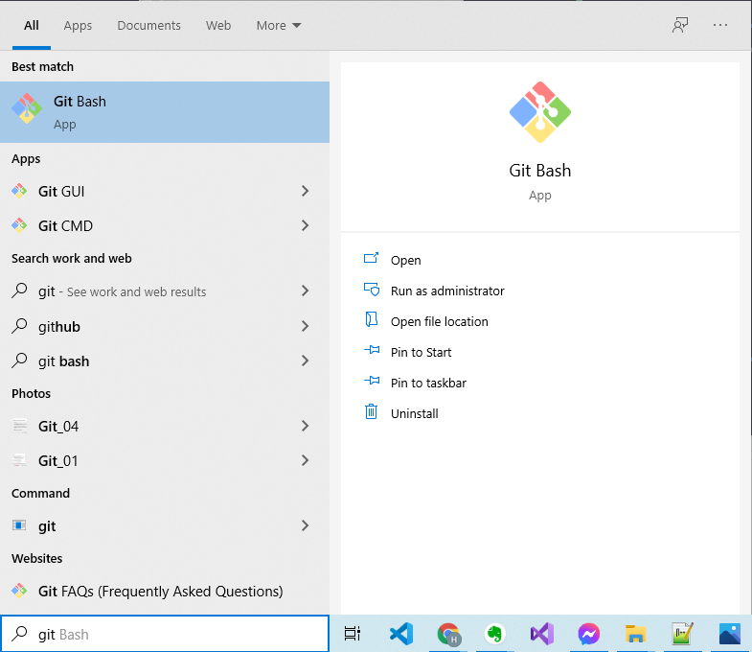
Verifying Git Bash and Git GUI
Search for “Git” on Windows
Check if you have “Git Bash” and “Git GUI”
Slightly recommended but normal Git CLI will do
Notes:
For this workshop, having Git Bash and Git GUI will be slightly recommended. Worry not since I believe we all have Git installed but not necessarily these tools. We can do this in normal CLI as it’ll still be able to read Git commands. But for those who want to follow along, here are the steps. This should be pretty straightforward but I’ve provided images just to make sure.

Slide 12
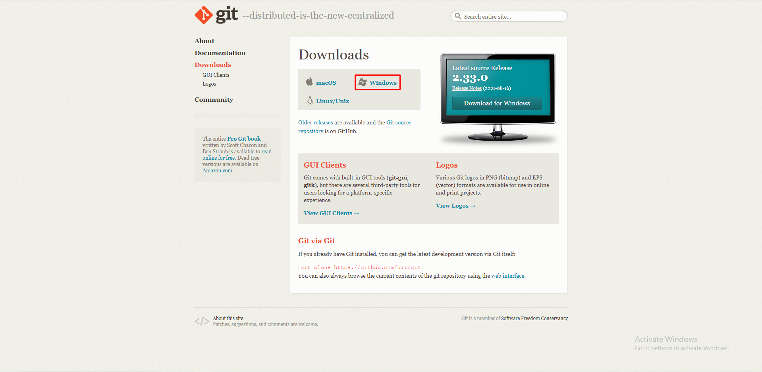
Download From https://git-scm.com/downloads

Slide 13
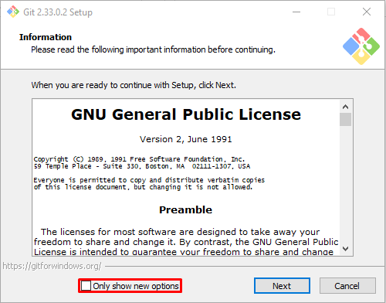
Installer Steps

Slide 14
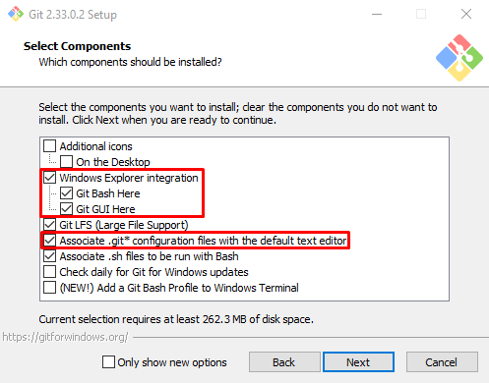
Installer Steps

Slide 15
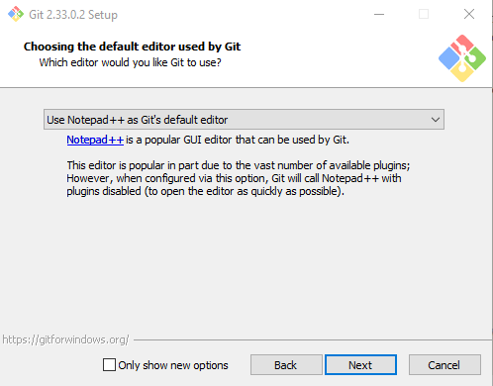
Installer Steps

Slide 16
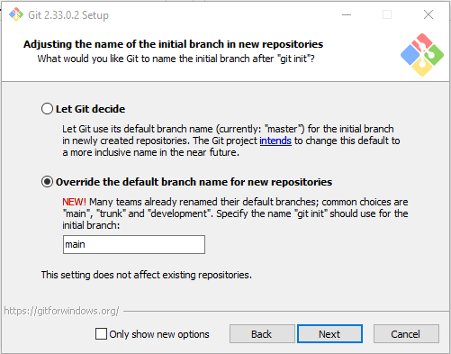
Installer Steps

Slide 17
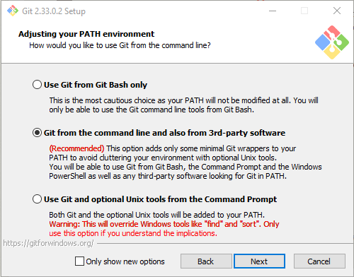
Installer Steps

Slide 18
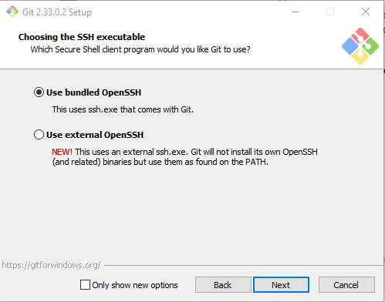
Installer Steps

Slide 19
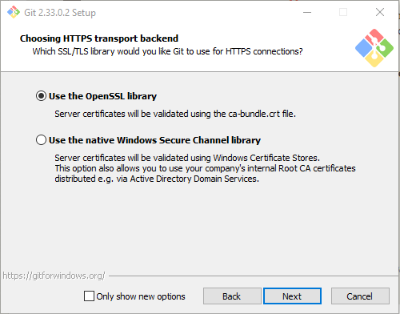
Installer Steps

Slide 20
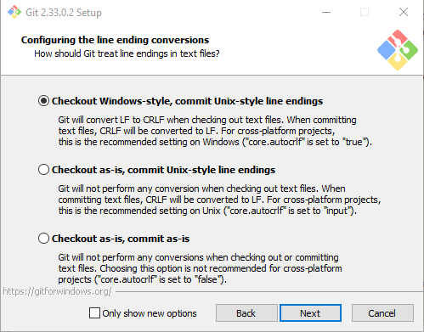
Installer Steps

Slide 21
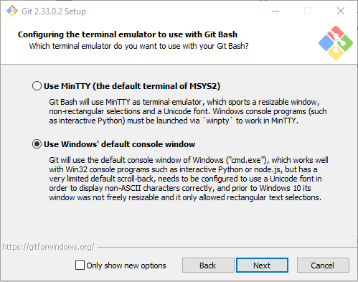
Installer Steps

Slide 22
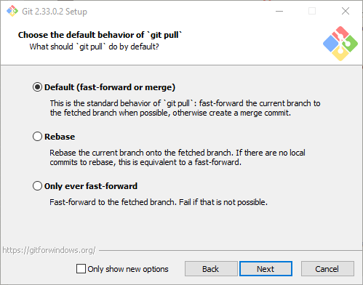
Installer Steps

Slide 23
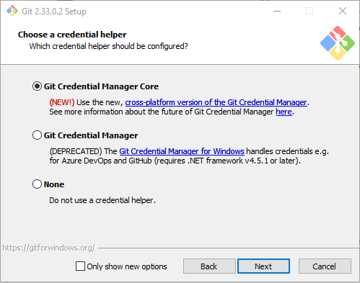
Installer Steps

Slide 24
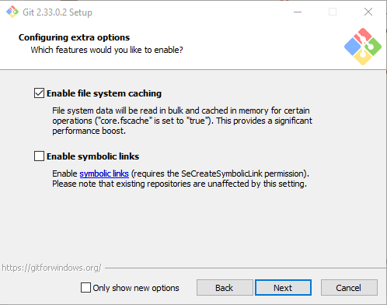
Installer Steps

Slide 25
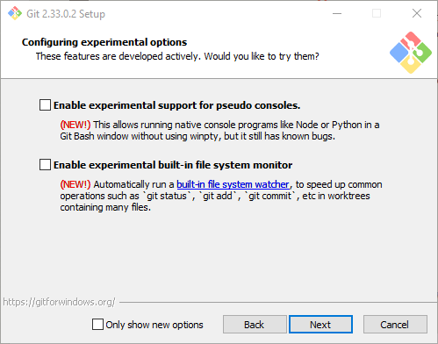
Installer Steps

Slide 26
Git Config - Aliases

Slide 27
Notes:
Then, we can set up Git aliases so we don’t have to memorize commands that we frequently use.

